Slide 1
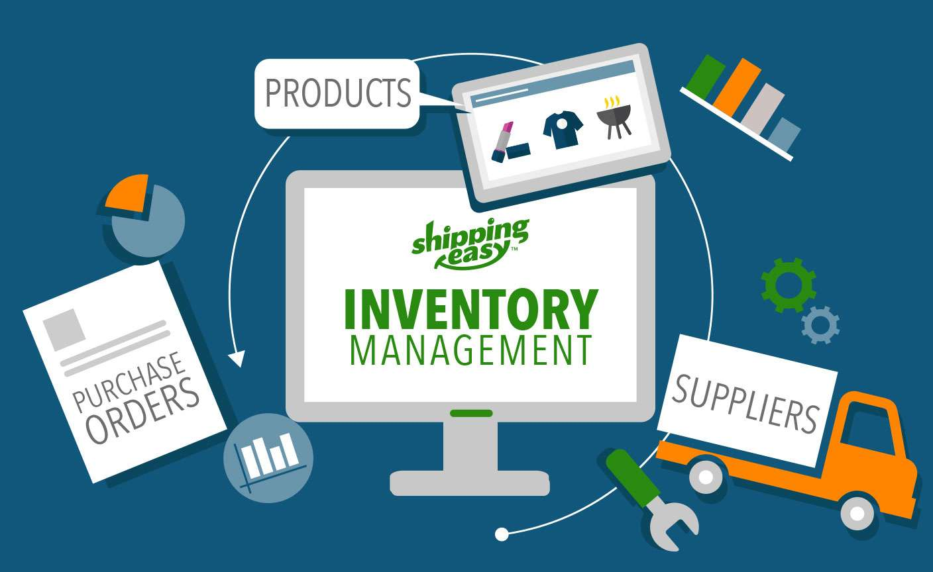
INVENTORY MANAGEMENT SYSTEM
Project by:
Sonika Prakash

Slide 2
INTRODUCTION
Retail inventory management is the process of ensuring you carry merchandise that shoppers want.
By managing inventory, retailers meet customer demand without running out of stock or carrying excess supply.
In practice, effective retail inventory management results in a number of benefits.
Retail inventory management tools and methods give retailers more information with which to run their businesses.

Slide 3
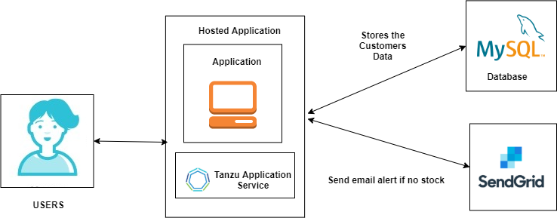
PROPOSED ARCHITECTURE

